Slide 1


AWS AI FUNDING OPPORTUNITIES
From business case to production
Qualified opportunities may be eligible for applicable AWS Partner funding. Pronix.ai helps shape the case, architecture, measures and production path; AWS makes the funding decision.
01
AI Readiness Assessment
02
Production-Path AI POC
03
Productionize & Scale
Prioritize the right use case.
Evaluate business value, data and integration readiness, AWS architecture, governance and POC scope.
Decision: prioritized use case + production roadmap.
Validate a defined use case.
Test measurable business and technical criteria across Agentic AI, GenAI/RAG, Bedrock, CX, Voice AI and automation.
Decision: production architecture + implementation plan.
Turn validated work into an operated workload.
AI engineering, enterprise integration, security, governance, deployment, managed operations and Forward Deployed Engineering.
Outcome: production adoption at enterprise scale.
Business Problem
AI Use Case
AWS Architecture
Funding Evaluation
Assessment / POC
Production
Scale
Qualification signals
Executive sponsor · defined problem · credible AWS workload · success criteria · data and controls · production decision
Check your AWS AI funding fit
pronix.ai/campaigns/aws-ai-funding
AWS determines funding availability, eligibility, funding type and amounts under applicable program requirements. References to AWS funding do not constitute a guarantee.
AWS AI funding opportunities · Executive briefing
1
Notes:
Objective: Frame funding as an accelerator within a production AI lifecycle—not as the product.
Talk track: Keep the discussion focused on executive decisions, production readiness and the stakeholder’s own business case.
Evidence: Approved Pronix.ai AWS funding campaign content and funding disclaimer.
Transition: Choose assessment or POC based on decision maturity.

Slide 2

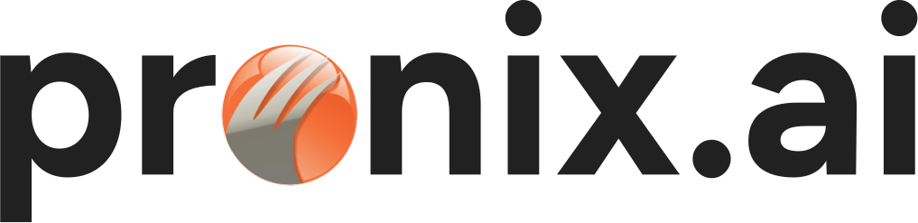
AWS AI ASSESSMENT FUNDING
Choose the right AI opportunity before you fund the build
An AWS AI readiness assessment helps leadership identify what should move first—and whether the opportunity can reach production with a credible case, architecture and control model.
BUSINESS VALUE
×
FEASIBILITY
×
DATA READINESS
×
PRODUCTION POTENTIAL
= INVESTMENT PRIORITY
01
What the assessment covers
02
What leadership receives
Executive problem, sponsor and outcome
Use-case prioritization and readiness scorecard
Data, integration, security and governance readiness
AWS target architecture and KPI/ROI hypothesis
Prioritized Use-Case Matrix
AWS Target Architecture + Data & Integration Map
KPI/ROI Hypothesis using customer baselines
Defined POC Scope + Production Roadmap
Assessment
Prioritized Use Case
POC
Production
Scale
Managed AI Operations
BEST FIT
Several AI demands compete for investment, the first use case is not agreed, or leadership needs a defensible production decision.
Evaluate My AWS AI Assessment
Applicable AWS Partner programs may support qualified assessment activities. AWS determines availability, eligibility, funding type and amount; approval is not guaranteed.
AWS AI assessment funding · Executive briefing
2
Notes:
Objective: Position the assessment as an executive decision instrument, not an open-ended discovery exercise.
Talk track: Keep the discussion focused on executive decisions, production readiness and the stakeholder’s own business case.
Evidence: Approved Pronix.ai AWS AI assessment campaign content.
Transition: If the use case and sponsor are already defined, move to the POC path.

Slide 3
AWS AI POC FUNDING
Validate the business case—and the AI system—before production
Pronix.ai designs a production-path POC on AWS with business and technical success criteria, architecture, data controls and the production decision defined up front.
Agentic AI
GenAI + RAG
Amazon Bedrock
Contact Center AI
Voice AI
AI Automation
01
A strong POC starts with
02
Executive decision outputs
Defined business problem and executive sponsor
Technical owner, identified enterprise data and credible AWS workload
Measurable business and technical success criteria
Security, privacy and governance requirements
A production decision if validation succeeds
Working POC + measured results
Production architecture, risks and controls
Implementation roadmap
Business lens: productivity, resolution, containment, accuracy and unit economics
AI lens: grounding, response quality, latency, reliability, tool execution, cost and security
Scope
Build
Validate
Measure
Executive Readout
Production Decision
Evaluate My AWS POC
pronix.ai/campaigns/aws-poc-funding
Qualified opportunities may be eligible for applicable AWS funding. AWS determines funding availability, eligibility, funding type and amount; no universal amount or approval is guaranteed.
AWS AI POC funding · Executive briefing
3
Notes:
Objective: Show how a POC becomes an evidence-based production decision rather than a disconnected demo.
Talk track: Keep the discussion focused on executive decisions, production readiness and the stakeholder’s own business case.
Evidence: Approved Pronix.ai AWS AI POC campaign content.
Transition: Close with Pronix.ai credentials and ecosystem breadth.

Slide 4
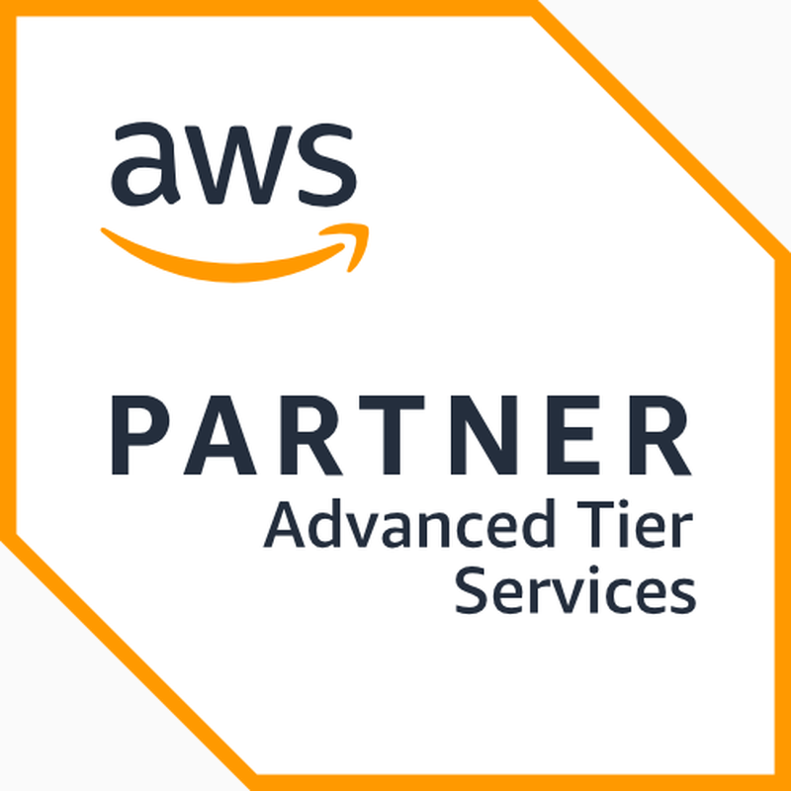
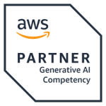
2010
200+
15+
SPECIALIZED AI & CX SYSTEMS INTEGRATOR
Founded
Certified engineers & architects
Average years enterprise delivery experience
From strategy and pilots
to production outcomes.
100+
3
24×7
Enterprise clients worldwide
Global delivery regions
Managed operations
Pronix.ai is the AI & CX systems integration practice of Pronix Inc., combining specialized expertise, enterprise integration and production execution.
ADVISE
→
IMPLEMENT
→
RUN
VERIFIED AWS CREDENTIALS
PARTNER & PLATFORM ECOSYSTEM
Enterprise AI & Agentic AI · CX & Contact Center AI · AI Business Automation
Microsoft · Google Cloud · Amazon Connect · Genesys Cloud CX · NICE · Five9 · Kore.ai · Salesforce · OpenAI · Claude
US-based architecture and program leadership with global engineering pods supporting build, cutover, hypercare and 24×7 managed operations.
Platform names are descriptive ecosystem references and do not imply a stronger alliance status than separately verified credentials.
pronix.ai
pronix.ai/contact
Headquarters: Plainsboro, New Jersey, USA · Delivery: United States · India (Hyderabad) · EMEA
Security questionnaires, controls documentation and named client references are available under NDA.
Pronix.ai company profile · Executive briefing
4
Notes:
Objective: Establish Pronix.ai’s scale, delivery model and verified AWS credentials.
Talk track: Keep the discussion focused on executive decisions, production readiness and the stakeholder’s own business case.
Evidence: Approved Pronix.ai company facts and partner credential artwork.
Transition: Invite the stakeholder to identify one priority AI opportunity for a working session.

